Slide 1


Lavazza Project

Slide 2

Table of Contents
Value Proposition
Project Goal
Data Overview
Research Questions
Pipelines
Models
Evaluation strategy
Checkpoint 2

Slide 3
Project Value Proposition
For marketers seeking deeper insights on product launches, our analytics software transforms raw online comments and reviews into actionable metrics.

Slide 4
Project Goal
Developing an application software in order to understand the real impact of a product launch, in terms of consumers sentiment crossing social media comments and third-party reviews.

Slide 5





Experiments - Data
Data Sources:
Wonderflow
Digiming
YouTube
Instagram
Generative Models
Datasets:
Reviews
Comments
Synthetic Comments

Slide 6
Experiments - Datasets
Reviews:
Records: 2930
Reviews labelled for Sentiment Classification: 96,5% of the reviews have at least one label between positive, negative and neutral topics.
Reviews labelled for Star Rating: 100%
Tiny Eco Reviews: 79
Comments:
Records: 573
Labelled Comments: 0%
Tiny Eco Reviews: 76
Synthetic Comments:
Records: 236
Labelled Comments: 100%

Slide 7
Research questions
Can Large Language Models be used to extract useful insights from consumers comments and reviews to improve marketing strategies?
In particular:
How effectively can LLMs identify product-relevant comments?
To what extent LLMs are able to extract product aspects from reviews and comments and assign sentiments to them?
How successfully are LLMs able to assign a sentiment to comments and rating stars to reviews?

Slide 8
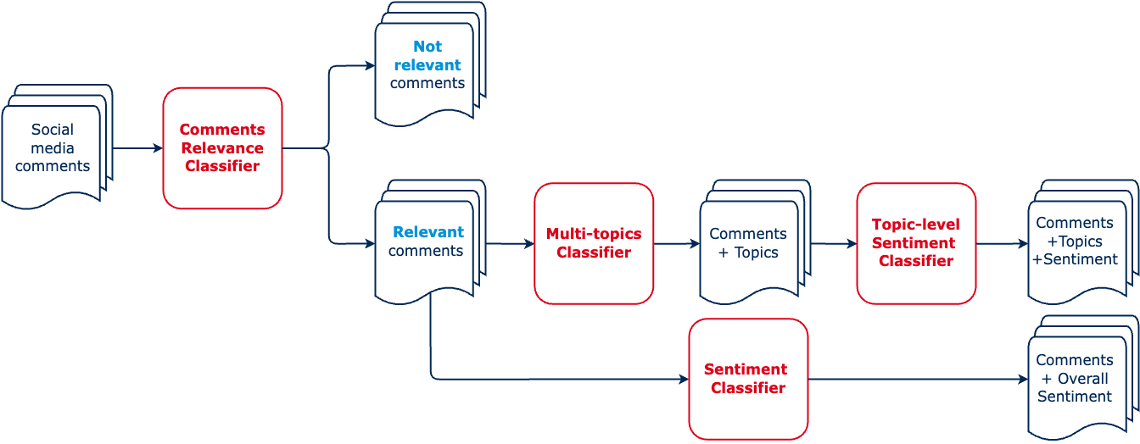
Classification Pipelines - Comments

Slide 9
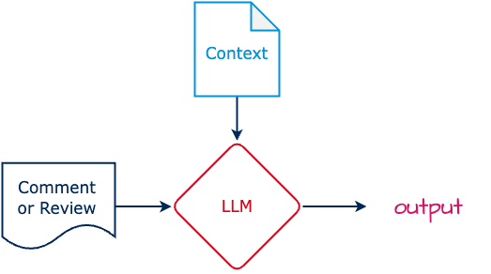
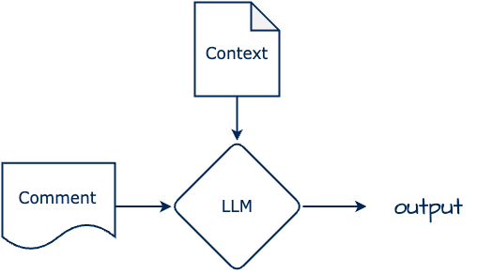
Models - Comments Relevance Classifier
Context: Detailed description of the product to which the comment should refer and few examples
Output: Relevance label

Slide 10
Classification Pipelines - Comments

Slide 11
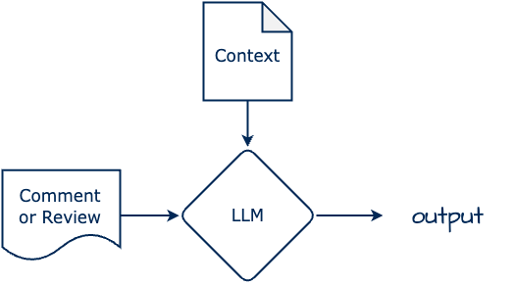
Models - Multi-topics Classifier
Context: List of all the topics (product aspects) and few examples
Output: List of topics related to the input comment

Slide 12
Models - Topic-level Sentiment Classifier
Context: List of the topics related to the specific comment and few examples
Output: List of topic-level sentiments

Slide 13
Classification Pipelines - Comments

Slide 14
Models - Sentiment Classifier
Context: few positive and negative examples
Output: Overall sentiment of the comment

Slide 15
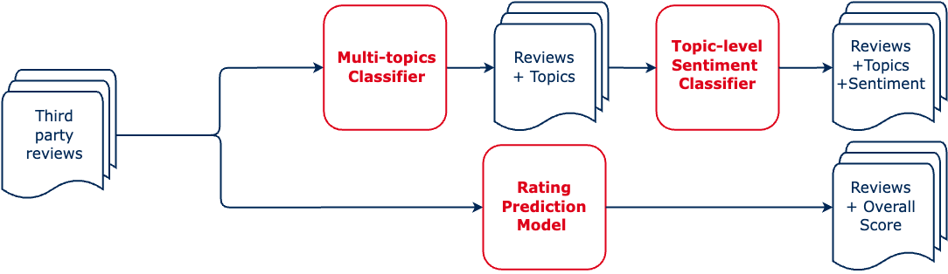
Classification Pipelines - Reviews

Slide 16
Models - Rating Prediction Model
Context: Brief description of the stars and examples of rated reviews
Output: Star rating for each review

Slide 17
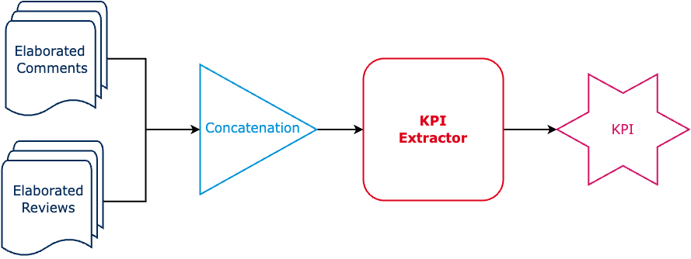
KPI Extraction Pipelines

Slide 18


LLM
Gemma2: large language model from Google, different versions: 2B, 9B and 27B
Llama3: large language model from Meta, 8B, 70B and 405B

Slide 19
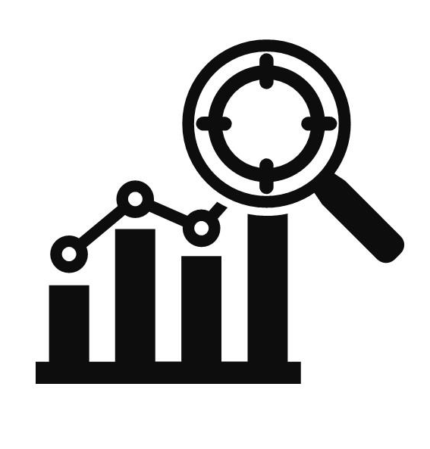
Evaluation strategy
Quantitative:
Performance of classification models and topic modeling tasks via leveraging synthetic data and our data
Qualitative:
Alignment with marketing objectives via meetings with stakeholders

Slide 20
Thank you
Alessio Gioè - Catalano Vincenzo - Tommaso Mazzarini

